Slide 1
Comparison between different compression techniques

Slide 2
Introduction
Lossless compression techniques, as their name implies, involve no loss of information. If data have been lossless compressed, the original data can be recovered exactly from the compressed data. Lossless compression is generally used for applications that cannot tolerate any difference between the original and reconstructed data.
Text compression is an important area for lossless compression.
It is very important that the reconstruction is identical to the original text, as very small differences can result in statements with very different meanings. Consider the sentences “Do not send money” and “Do now send money.” A similar argument holds for computer files and for certain types of data such as bank records.
Various lossless data compression algorithms have been proposed and used. Some of the main techniques in use are
The Huffman Coding
Run Length Encoding
The Shannon Fano Algorithm

Slide 3
Literature Survey
Data compression is a common requirement for many computer systems. There are many ways to compress data,dedicated to compressing different data formats. Or for one type of data, there are many compression algorithms,using a variety of methods. This project examines algorithms for data loss loss and compares its performance. Collection ofSelected algorithms are tested and used to test the performance of compressed text data. Test comparisons of a number of different data compression algorithms that are missing are brought to this project. This survey concludes according to which algorithmworks well with text details[2].
Data compression is a way to capture data for data storage is very efficient and requires only a small amount of storage space In addition, data congestion can reduce data timeto exchange. Currently, there are many methods that can be usedpress data. And each method has different effects and methods.

Slide 4
In this paper, we will discuss comparisons of data compressionusing 3 different algorithms, using Shannon-FanoAlgorithm, Huffman Algorithm, and Run Length EncodingAlgorithm[3].
Data compression is an important issue in the field of computer science, information theory, and the concept of writing. The need to compress data is to reduce the size of the data in order for its storage and transfer to work properly. Motivated to resolve text data compression, we introduced a novel coding algorithm that works on any text data. In addition, the design of this algorithm paves the way for the novelty so that researchers can build on it and better solve the problem of text data.

Slide 5
Shannon- fano ,Run length, & huffman coding algorithms are compare according to their performances. Data compression is a minimizing processdata size, deleting excess data. Short data size is appropriate because it simply reduces costs. The purposeof data compression reduces the retrieval of stored or transferred data, thereby increasing the effective data density. DataSqueezing an important application in the system repository and distribution of programs because it is still distributing system dataI have to post from all programs. It is therefore used for data compression speed and efficiency. There is a numberof various data compression methods, used to compress different data formats such as text, video, audio,image files. There are two types of data compression "lossless" and "lossey", in the reduction of data loss, the integrity ofdata is saved[1].

Slide 6
Objective
The aim of this project is to comparing & evaluating the performance of the algorithms.
To compare the performances of the selected algorithms the compression and decompression times, and compressed file sizes are compared because after compression the size of file we get is less than the size of original file so we analyse algorithm so that we can find out that which algorithm works best on the basis on their measuring factor like:
Compression Ratio
Compression Factor
Compression & decompression time

Slide 7
Algorithm
We have selected 3 algorithm for comparison
1) The Huffman Coding
2) Run Length Encoding
3) The Shannon Fano Algorithm

Slide 8
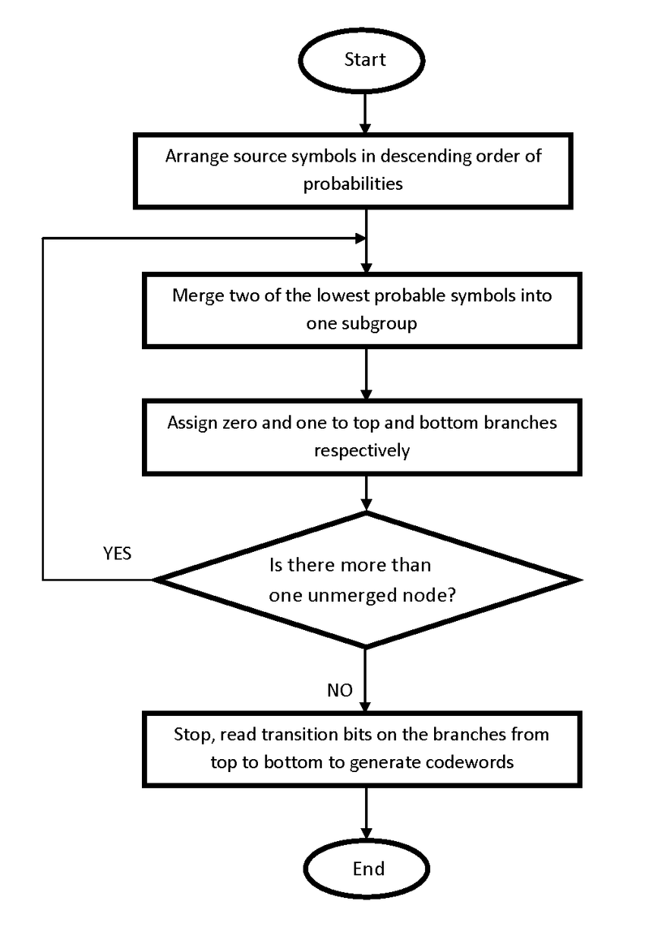
Hoffman Coding Algorithm Flowchart

Slide 9
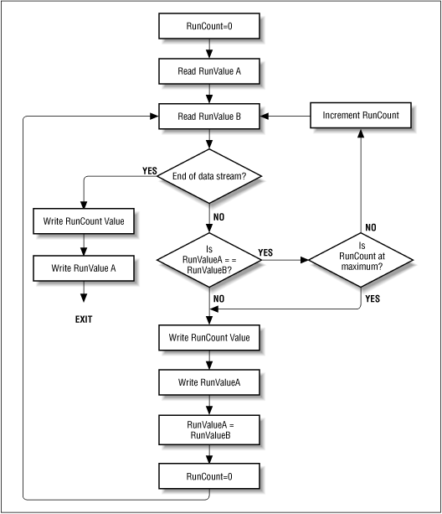
Run Length Encoding Flowchart

Slide 10
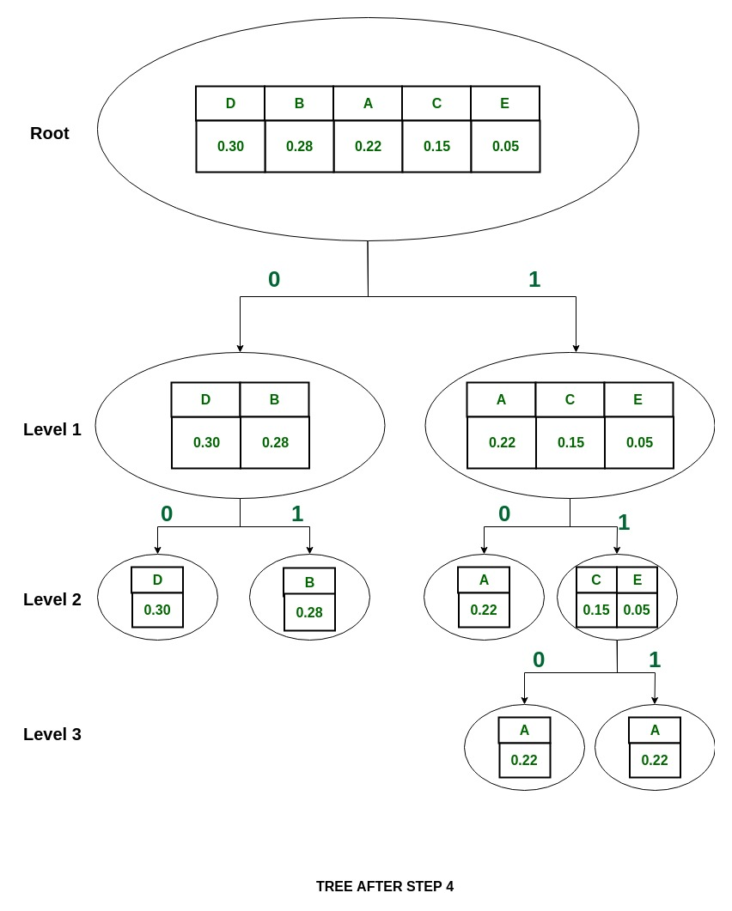
The Shannon Fano Algorithm Flowchart

Slide 11
Status of project
All the three algorithm i.e. Hoffman Coding, Run Length and Shannon Fano have been thoroughly studied.
Clear objective of this project has been achieved i.e. compression of a input text data to all the three algorithm and then according to the compression ratio of algorithms the best algorithm will be selected.
Literature Survey is done.

Slide 12
References
Dea[ Ayu Rachesti, Tito Waluyo Purboyo and Anggunmeka Luhur Prasasti “Comparison of Text Data Compression Using Huffman, Shannon-Fano, Run Length Encoding, and Tunstall Methods”International journal of Applied Engineering Research ISSN 0973-4562 Volume 12, Number 23(2017) pp. 13618-13622 Telkom University, Bandung, Indonesia.
S.R. KODITUWAKKU , U. S.AMARASINGHE“ comparison of lossless data compression algorithms for text data” S.R. Kodituwakku et. al. / Indian Journal of Computer Science and Engineering Vol 1 No 4 416-426. University of Peradeniya
Shrusti Prowal, Yashi Chaudhary, Jitendra Joshi, Manish Jain “Data Compression Methodologies for Lossless Data and Comparison between Algorithms”
International Journal of Engineering Science and Innovative Technology (IJESIT) Volume 2, Issue 2, March 2013. Jayoti Vidyapeeth Women’s University.

Slide 13
Vinay
Roll No.- R103218167
Tushar Goyal
Roll No.- R103218163 Mentor Name
Shivam Sahu Astt. Proff.-Shashi Bhushan
Roll No.- R103218140
Sourabh Verma
Roll No.- R103218156

